Slide 1
Google File System
Dr. Salahuddin

Slide 2
Google FILE SYSTEM (GFS)
GFS is scalable distributed file system
Used for larger distributed data intensive application
GFS provides fault tolerance
Runs on inexpensive hardware
Deliver high performance to larger number of clients
Files are organized hierarchically in directories and identified by path name
Supports usual operations such as create delete open close read write files.

Slide 3
Two operations are performed
Snapshot operation: create copy of file or a directory at very low cost
Record operation: it will allows multiple clients to append data to the same file on currently.
The Google File System reduced hardware flaws while gains of commercially available servers.
GoogleFS is another name for GFS. It manages two types of data namely File metadata and File Data.
The GFS node cluster consists of a single master and several chunk servers that various client systems regularly access. On local discs, chunk servers keep data in the form of Linux files. Large (64 MB) pieces of the stored data are split up and replicated at least three times around the network. Reduced network overhead results from the greater chunk size.

Slide 4
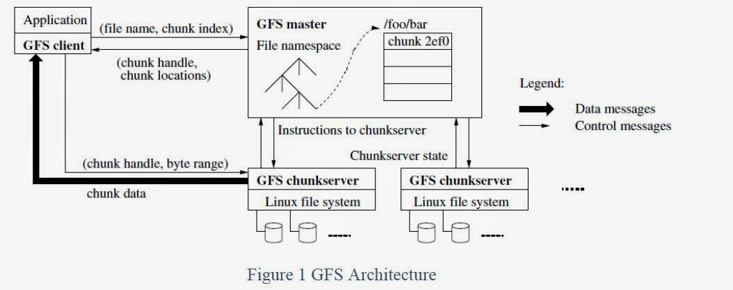
GFS Architecture neat sketch

Slide 5
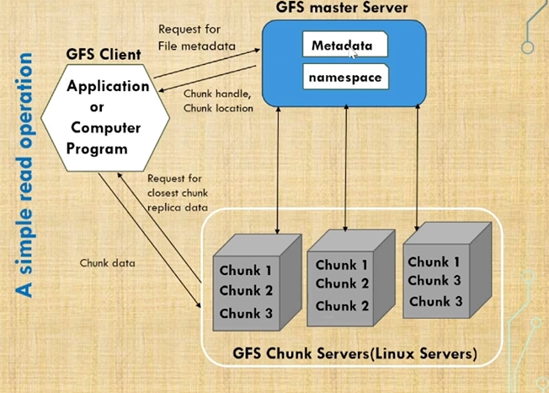
GFS Architecture neat sketch

Slide 6
GFS Architecture neat sketch
GFS is clusters of computers. A cluster is simply a network of computers. Each cluster might contain hundreds or even thousands of machines. In each GFS clusters there are three main entities:
1. Clients
2. Master servers
3. Chunk servers.

Slide 7
Client can be other computers or computer applications and make a file request. Requests can range from retrieving and manipulating existing files to creating new files on the system. Clients can be thought as customers of the GFS.
Master Server is the coordinator for the cluster. Its task include:-
1. Maintaining an operation log, that keeps track of the activities of the cluster. The operation log helps keep service interruptions to a minimum if the master server crashes, a replacement server that has monitored the operation log can take its place.
2. The master server also keeps track of metadata, which is the information that describes chunks. The metadata tells the master server to which files the chunks belong and where they fit within the overall file.

Slide 8
Chunk Servers are the workhorses of the GFS. They store 64-MB file chunks. The chunk servers don't send chunks to the master server. Instead, they send requested chunks directly to the client. The GFS copies every chunk multiple times and stores it on different chunk servers. Each copy is called a replica. By default, the GFS makes three replicas per chunk, but users can change the setting and make more or fewer replicas if desired.

Slide 9
Management done to overloading single master in Google File System
Having a single master enables the master to make sophisticated chunk placement and replication decisions using global knowledge. However, the involvement of master in reads and writes must be minimized so that it does not become a bottleneck. Clients never read and write file data through the master. Instead, a client asks the master which chunk servers it should contact. It caches this information for a limited time and interacts with the chunk servers directly for many subsequent operations.

Slide 10
General scenario of client request handling by GFS
File requests follow a standard work flow. A read request is simple; the client sends a request to the master server to find out where the client can find a particular file on the system. The server responds with the location for the primary replica of the respective chunk. The primary replica holds a lease from the master server for the chunk in question

Slide 11
How google file system differ from the Hadoop file system
The google is using its own File system that is GFS. The HDFS is inspired from the GFS. Both the file systems are using the master slave architecture. The GFS works on the Linux platform on the other hand the HDFS works on the cross platforms. GFS has two servers master node and chunk servers and the HDFS has name node and data node servers.

Slide 12
Features of GFS
Namespace management and locking.
Fault tolerance.
Reduced client and master interaction because of large chunk server size.
High availability.
Critical data replication.
Automatic and efficient data recovery.
High aggregate throughput.

Slide 13
Advantages of GFS
High accessibility Data is still accessible even if a few nodes fail. (replication) Component failures are more common than not, as the saying goes.
Excessive throughput. many nodes operating concurrently.
Dependable storing. Data that has been corrupted can be found and duplicated.

Slide 14
Disadvantages of GFS
Not the best fit for small files.
Master may act as a bottleneck.
unable to type at random.
Suitable for procedures or data that are written once and only read (appended) later.

